Slide 1
FRACTIONS of an amount

Slide 2
Objectives
Be able to calculate a fraction part of a number
and answer at least 5 questions on this topic
Be able to answer at least 1 exam question at your level about this topic.

Slide 3
So lets start with Fractions
How would you work out a half?
What is half of 100?
What is half of 220?
What is half of 350?
Now how about a quarter?
What is a quarter of 100?
What is quarter of 220?
What is quarter of 350?

Slide 4
Always use this formula for finding fractions of whole numbers:
‘Whole number ÷ denominator x numerator’
Numerator
3
55
of
5
Denominator
Whole number

Slide 5
Let’s try one...
3
5
5
of
5
÷
=
33
x
Whole number
Denominator
Numerator

Slide 6
Another one...
4
5
6
of
7
÷
=
32
x
Whole number
Denominator
Numerator

Slide 7
Follow the formula and it’s easy...
6
8
1
of
9
÷
=
54
x
Whole number
Denominator
Numerator

Slide 8
Last one...
9
9
6
of
12
÷
=
72
x
Whole number
Denominator
Numerator

Slide 9
Quick Practice
£8
1) Find 1/5 of £40
2) Find 2/3 of £27
3) Find 5/6 of £42
4) Find 3/7 of £56
1 minute
£18
£35
End
£24

Slide 10
Now let’s practice some more :
http://www.cimt.org.uk/projects/mepres/book7/bk7i10/bk7_10i3.htm
Or play the treasure hunt cards game

Slide 11
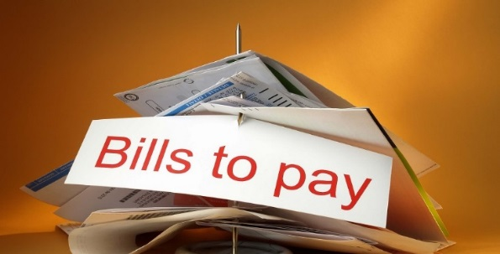
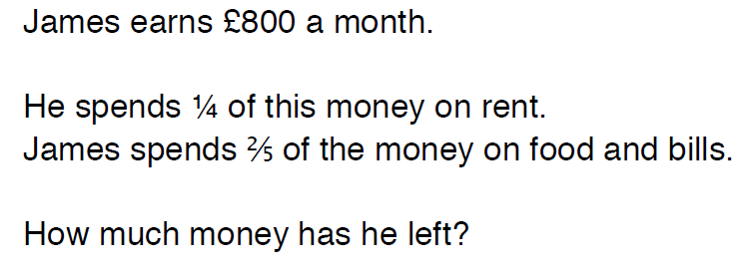
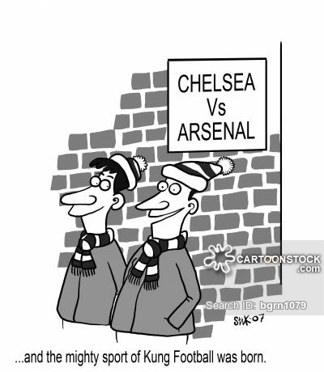
Exam Questions
(1)
£280
(2)
There are 35 students in the class, 3/5 of the pupils support Chelsea and the remainder support Arsenal.
How many students support Arsenal?
14 students

Slide 12
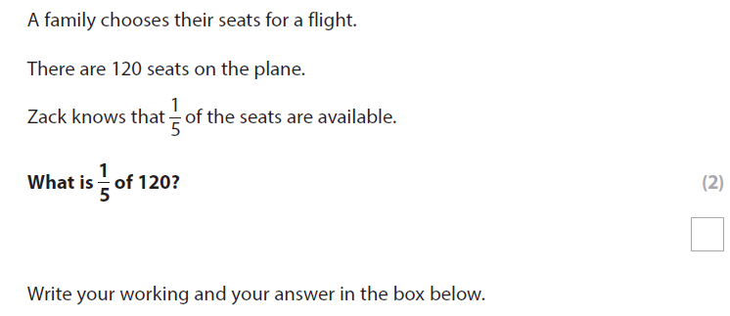
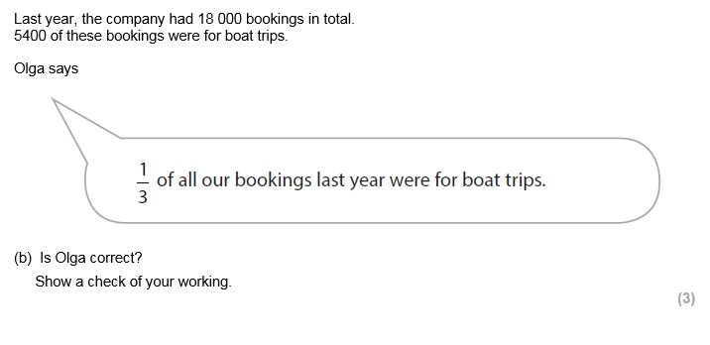
Exam question for you to work in your book
Entry 3 exam question
Level 1 exam question

Slide 13
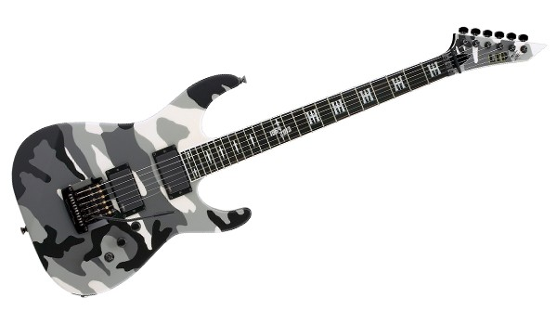
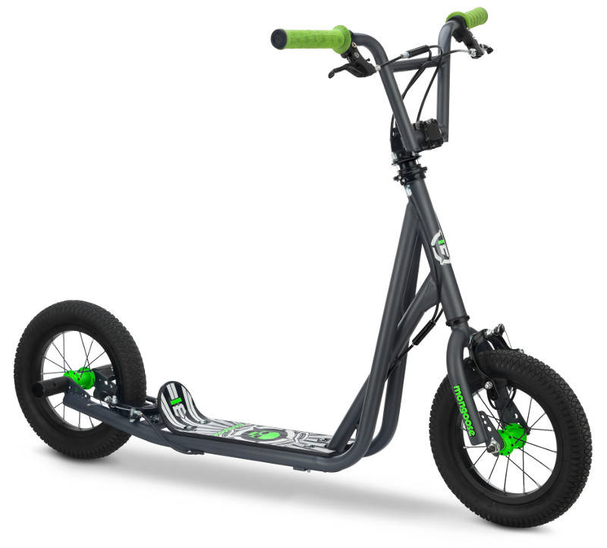
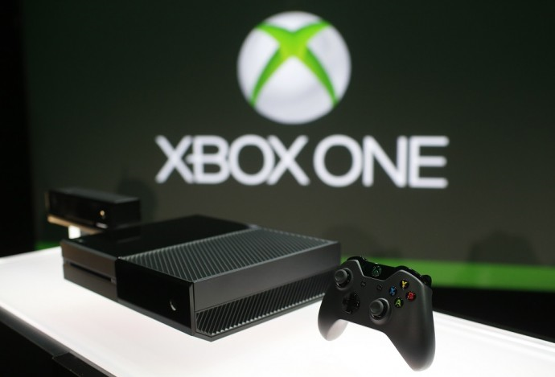
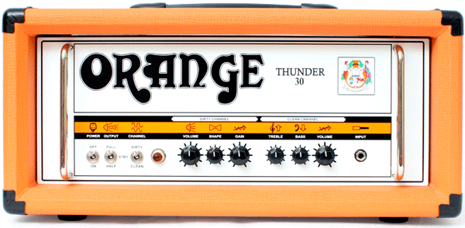
L.O: To reduce or increase amounts of money by different percentages
Must
Should
Could
£750
£1,200
£130
This guitar is reduced by 20% in the sale. What is its new price?
This 4K TV is reduced by 10% in the sale. What is its new price?
This scooter is increased by 20% for Christmas. What is its new price?
£250
£2,400
£540
This Xbox One is reduced by 10% in the sale. What is its new price?
This Orange amp is reduced by 30% in the sale. What is its new price?
This iPhone 6s is increased by 5% for Christmas. What is its new price?

